Slide 1

CREDIT
CARD
ANALYSIS
Project Owner : Shaboni Roy

Slide 2
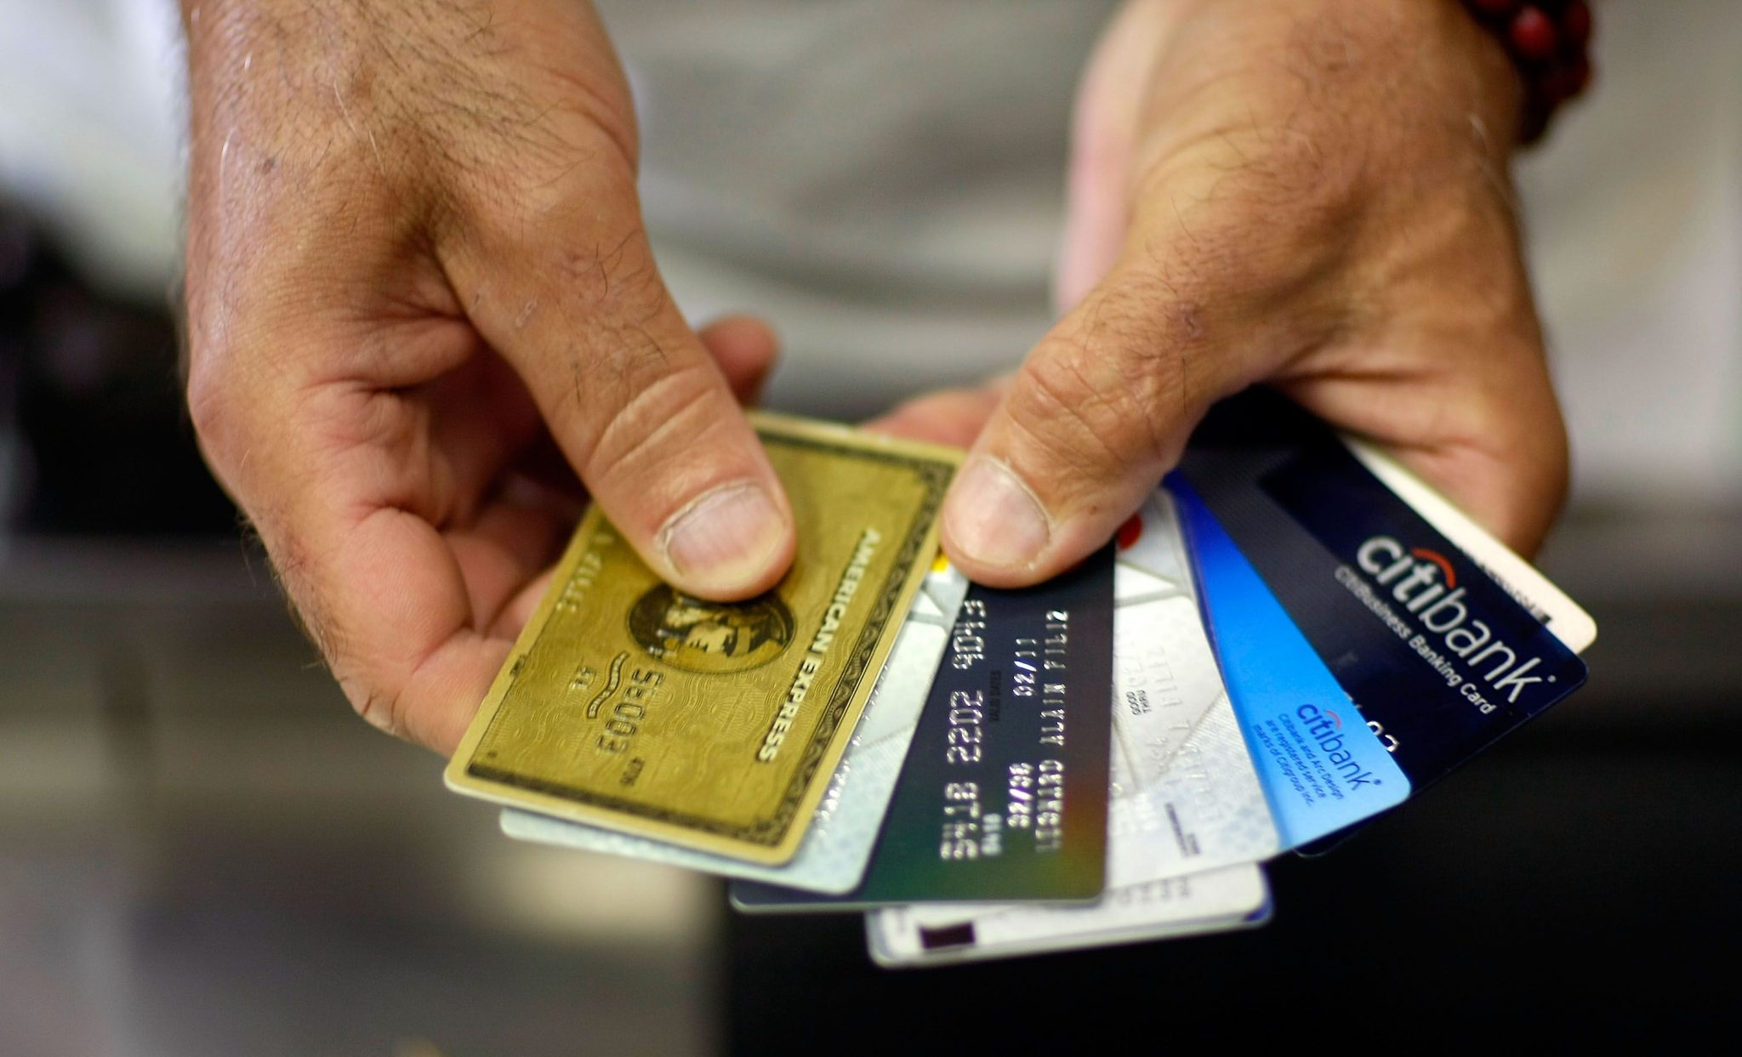
CONTENTS
INTRODUCTION
GOALS AND KPI’S
RECOMMENDED ANALYSIS
CONCLUSION

Slide 3
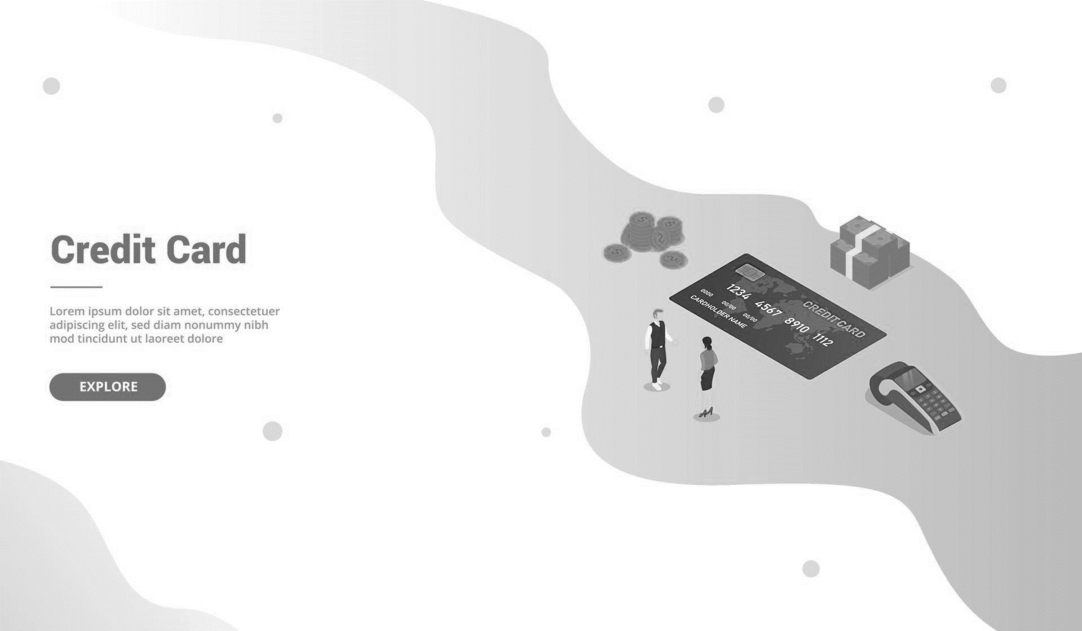

INTRODUCTION
Background : An overview of data which consist of 2 tables is given in this report. The first table is of credit card details which consist of 10109 rows, 18 columns and second table is of customer details which consist of 10109 rows, 13 columns is provided in the data. Before visualisation we analyse the data properly, check accuracy to derive the insights from data which will help us to find out what are the steps we should take to understand customer behaviour pattern while using credit card to ensure profitability.
Problem : The company is facing unstable performance around the work area of credit card so to understand the pattern of customers a comprehensive analysis has been done.

Slide 4


GOALS AND KPI’S
GOALS :
Customer segmentation
Targeted Marketing
Product Innovation
Market Insights
Transaction Monitoring and Compliance
KPI’S :
Total Revenue
Total Transaction Amount
Total Interest Earned
Total Transaction Count
Total Income
Average of Customer Satisfaction Score

Slide 5

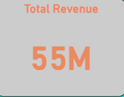
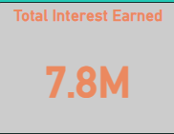

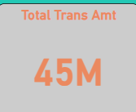
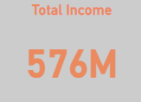
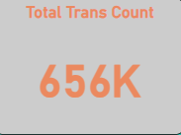
RECOMMENDED ANALYSIS
Total Revenue = 55M
Total Transaction Amount = 45M
Total Interest Earned = 7.8M
Total Count Of Transaction = 656K
Total Income = 576M
Average Customer Satisfaction Score = 3.19
Card Activation Rate is 57.47%
The Delinquent Rate is 6.07%
Male customers are contributing 30M in revenue whereas female customers are contributing 25M revenue.

Slide 6
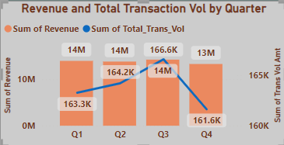
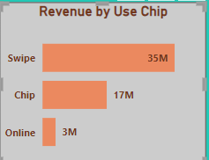
Which Quarter showed the highest Revenue and Total Transaction Volume?
Ans) Quarter 3 shows the highest Revenue as well as
Total Transaction Volume.
Which use chip has the highest revenue and also mention which one has the lowest revenue among all?
Ans) Highest Revenue – Swipe(35M)
Lowest Revenue – Online(3M)

Slide 7
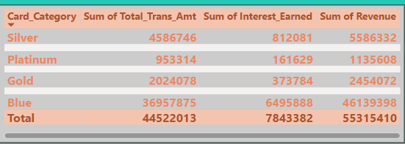
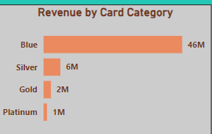
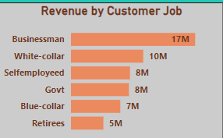
Which card category has the highest Total Transaction Amount, Interest Earned and Revenue? Ans) Card category ‘Blue’ has the highest Total Transaction Amount, Interest earned and Revenue.
According to Customer job, which customer spends the most revenue on credit card?
Ans) Businessman spends the most revenue
worth 17M on credit card.

Slide 8
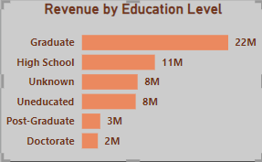
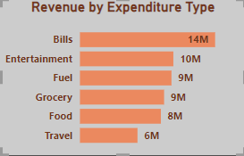
Which is the highest revenue spending by Education Level?
Ans) Highest revenue by Education Level is
Graduate with total revenue spending of
22M.
What is the highest spending of revenue by Expenditure type?
Ans) For payment of Bills there is highest
spending of revenue worth 14M and for travel
purposes there is lowest spending of revenue
worth 6M.

Slide 9
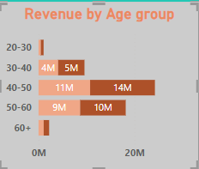
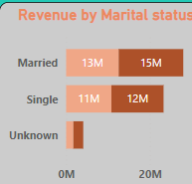
Which age group spends the highest revenue as well as lowest revenue on credit card?
Ans) Age group of 40-50 spends the highest revenue
on credit card and age group of 20-30 spends the
lowest revenue on credit card.
What is the most common martial status of customer spending the highest revenue?
Ans) Married Customer’s spends the highest
revenue on credit card.

Slide 10
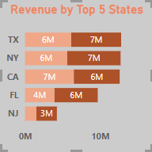
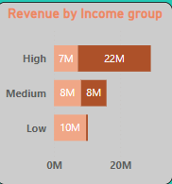
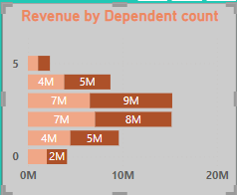
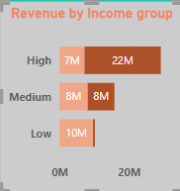
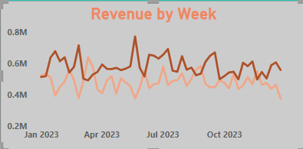
Name the five states where customers are spending the highest revenue on credit card?
Ans) The five states are:
1)TX
2)NY
3)CA
4)FL
5)NJ
Other Analysis :

Slide 11

CONCLUSION
The analysis of all the customers and their transaction done in this project showcases valuable, clear and decisive insights. We have found out how, what and why revenue and overall customer retention seems affected and then can enforce steps that corrects the shift based on the visualizations. these key trends and patterns in customer behavior will help businesses make knowledgeable decisions.

Slide 12
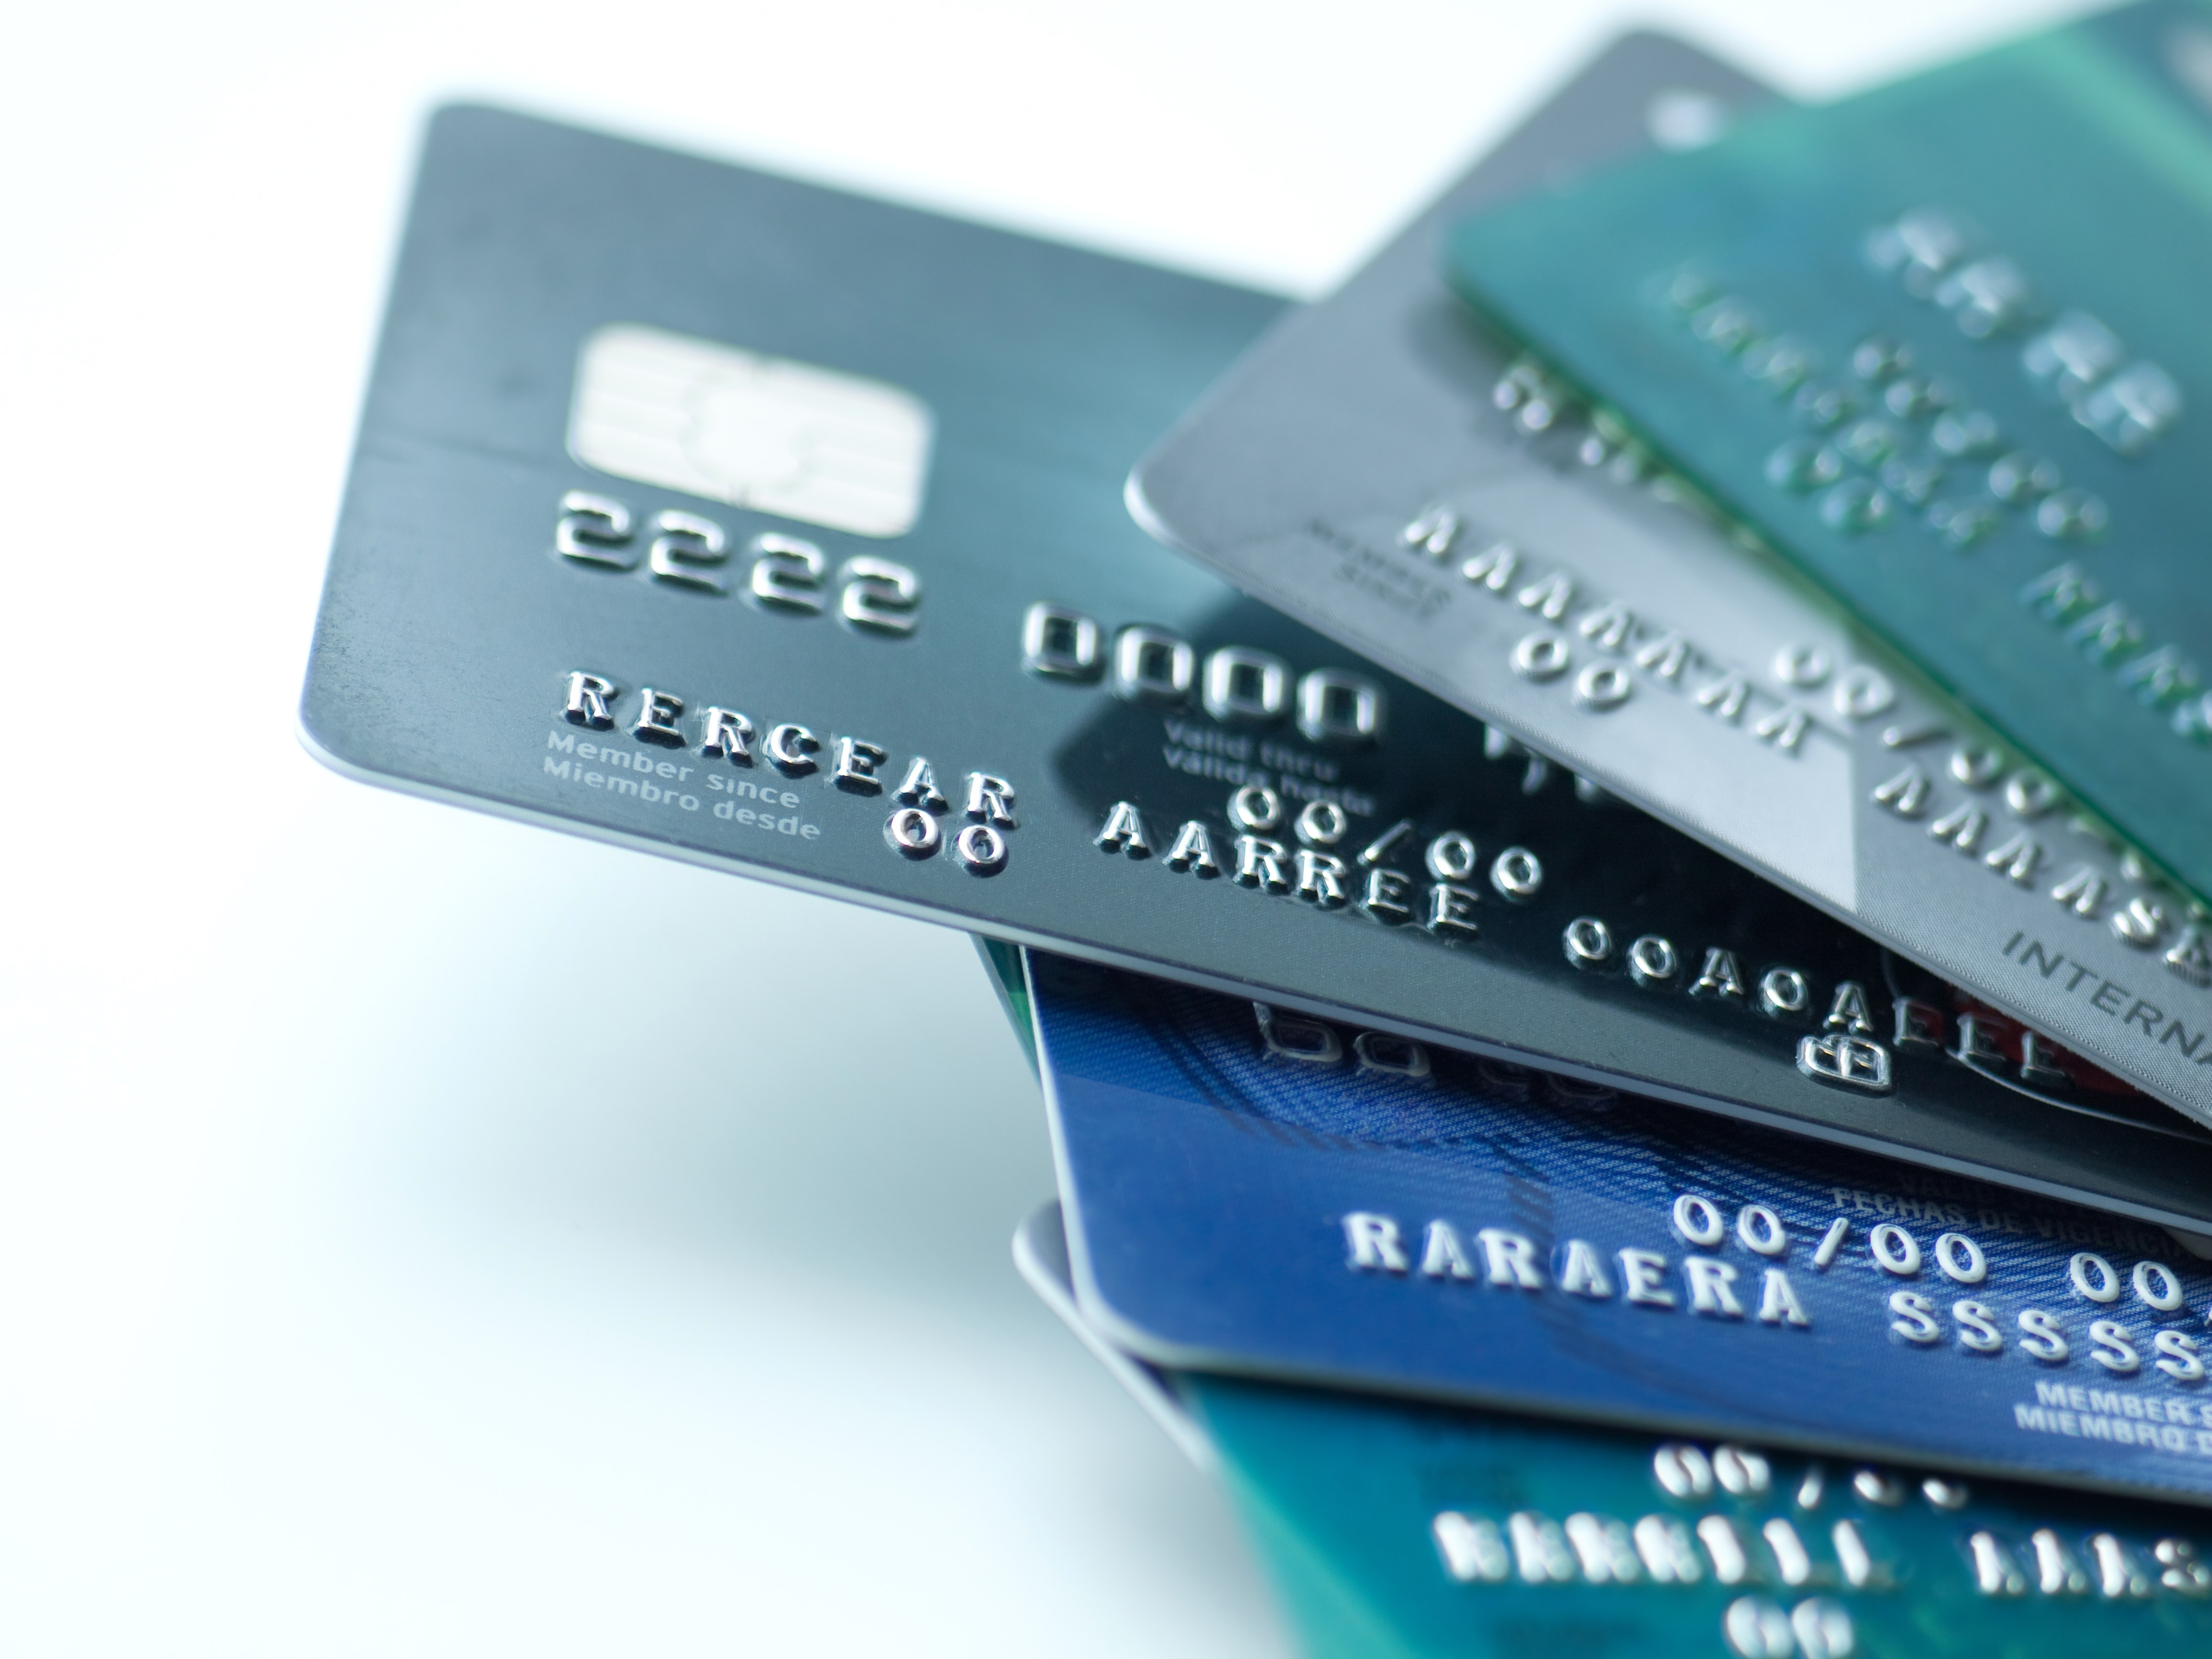


THANK YOU!
Do you have any questions?
shaboniroy05@gmail.com
https://www.linkedin.com/in/shaboni-roy-06a588226/

